Slide 1

MINI PROJECT SEMESTER- VI

Slide 2
HOME WORKOUT APP
Submitted to: Developed by:
Mr.Neeraj Khanna Raeyan (181500530)
Gopal Singh (181500241)
Priyanshi Goyal (181500512)
Kushal Maurya (181500298)

Slide 3
Introduction
The application is aimed at developing a workout model for people who needed to perform exercises in a conformable procedure. It is a mobile application designed with Android technology. Regular exercise has health and physical benefits which are hard to ignore. Health and physical fitness are the fundamental targets for the Application. It is designed to contain the built-in categories of workouts. The collection of workouts is meant to contain descriptions and procedures on how the workouts should be performed. The project is an Android Application targeted at people who like to keeps fit and keep track of their workout tasks and sets of workouts done at regular interval. A huge number of people work out without any workout plans, some do have plans but not well documented.

Slide 4
Problem Statement
In the modern era there has been an increasing amount of interest in physical fitness and health with the most people, there are people who have a full desire for that, but it may force them time or place conditions on the sometimes unsteadiness on a specific date for the exercise. Based on that project provided a mobile application for the exercise of fitness in every place and at any time, thus facilitated a lot trouble discipline on a specific place or a specific time in the day and helped them to calculate calories that are burned through sport exercise and eat healthy food. There are lot of applications that are interested in health, fitness and nutrition, but the user needs one application combines between them to facilitate the deal and user does not distract.

Slide 5
Objective
Provide guidelines to workout for different gender groups
Provide guidelines for healthy eating habits
Helps in monitoring the exercise pattern
To manage the health life system in health fitness and nutrition
To motivate the interest of health and physical fitness and nutrition.

Slide 6
Modules
Main page
Male workout page
Female workout page
BMI Calculator
Diet chart

Slide 7
Technologies Used
Android Studio

Slide 8
SOFTWARE DESIGN DIAGRAMS

Slide 9
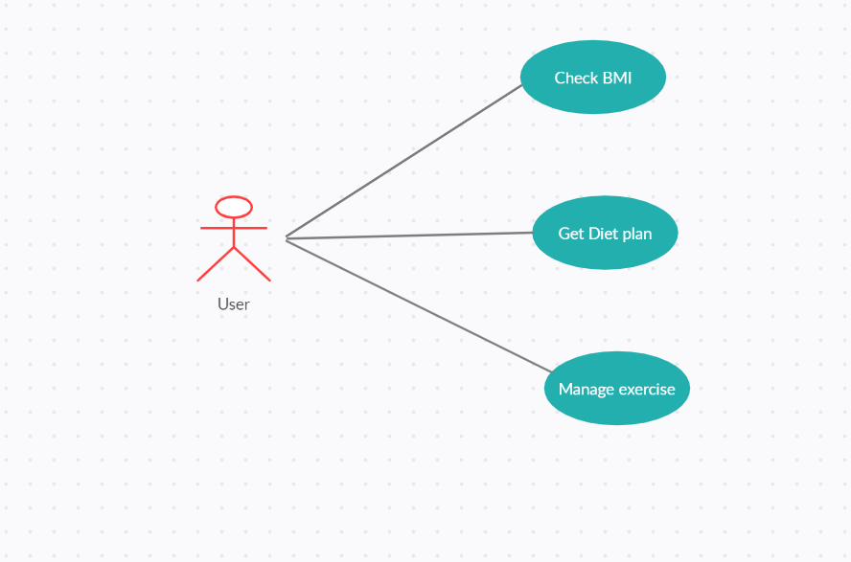
Usecase Diagram

Slide 10
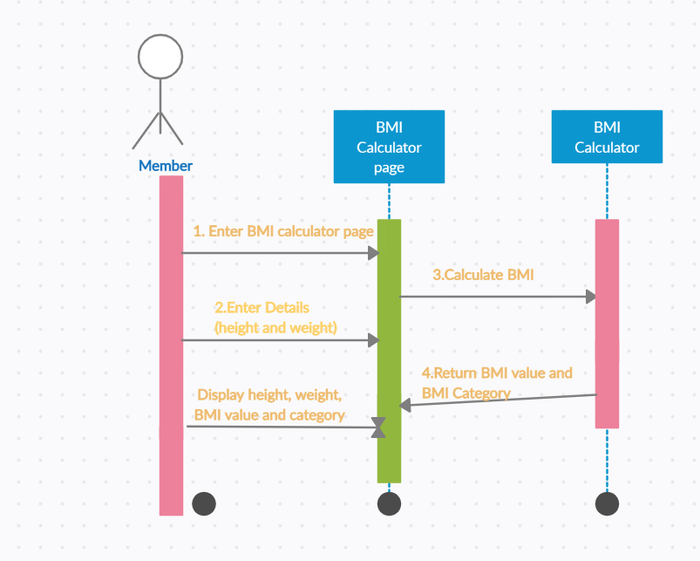
BMI Calculator Sequence Diagram

Slide 11
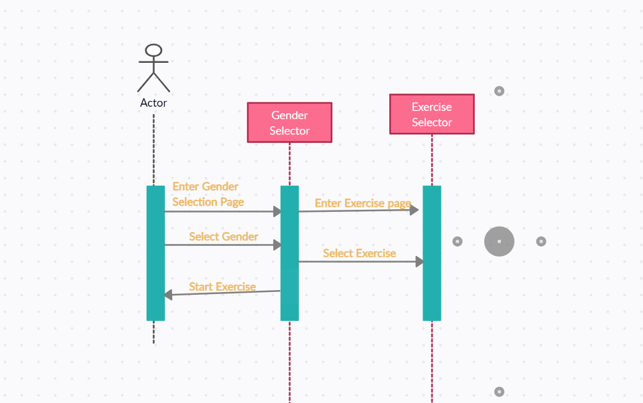
Workout Sequence Diagram

Slide 12
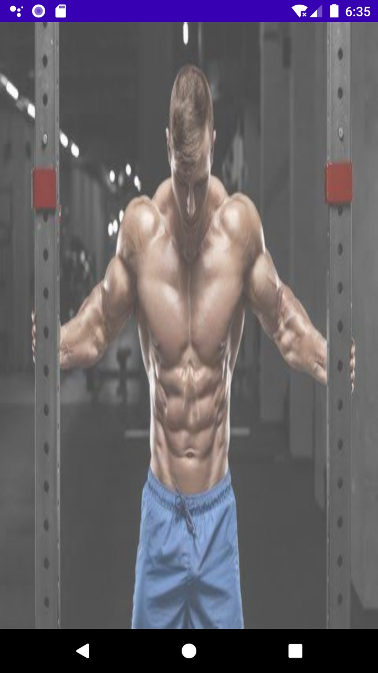
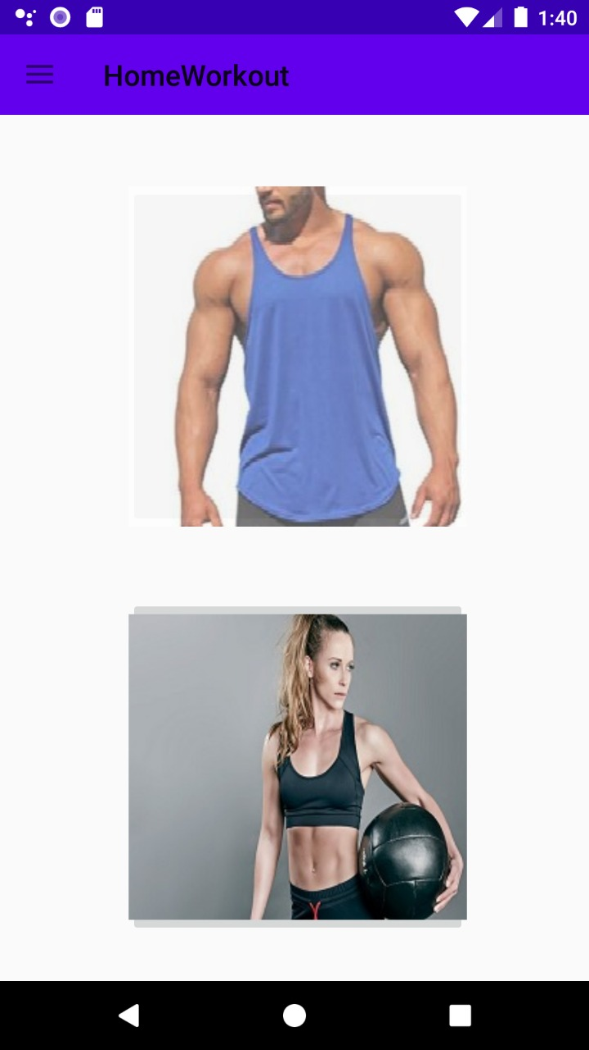
Implementation And User Interface

Slide 13
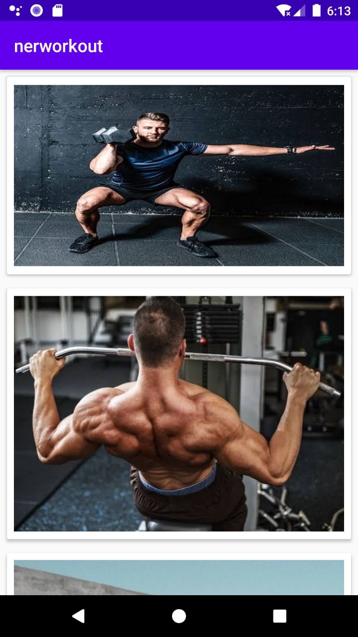
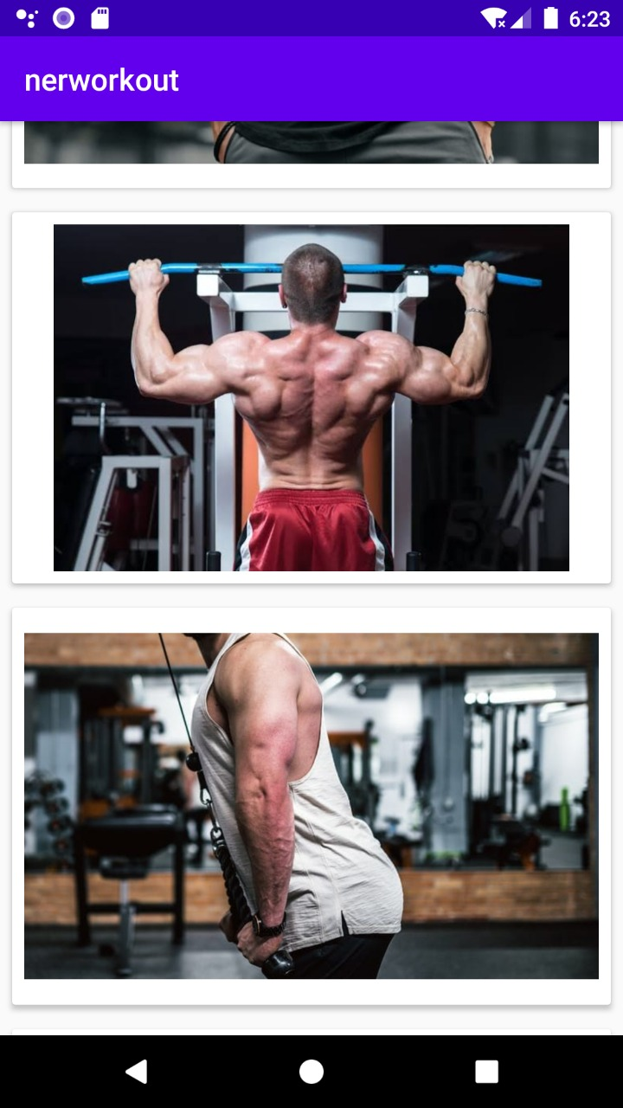
Male Workout Selection Page

Slide 14
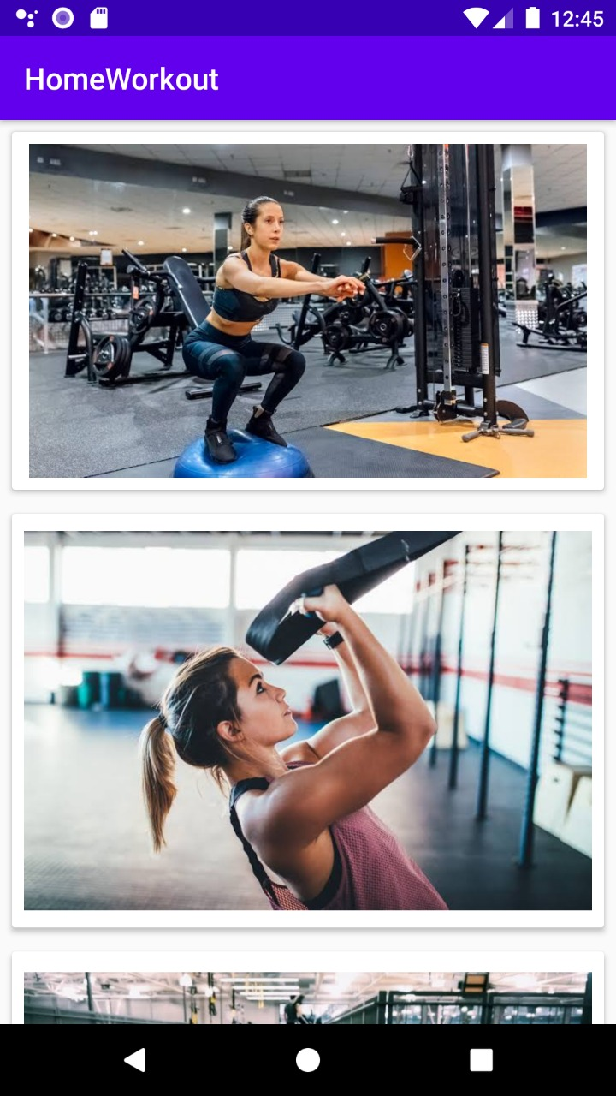
Female Workout Selection Page

Slide 15
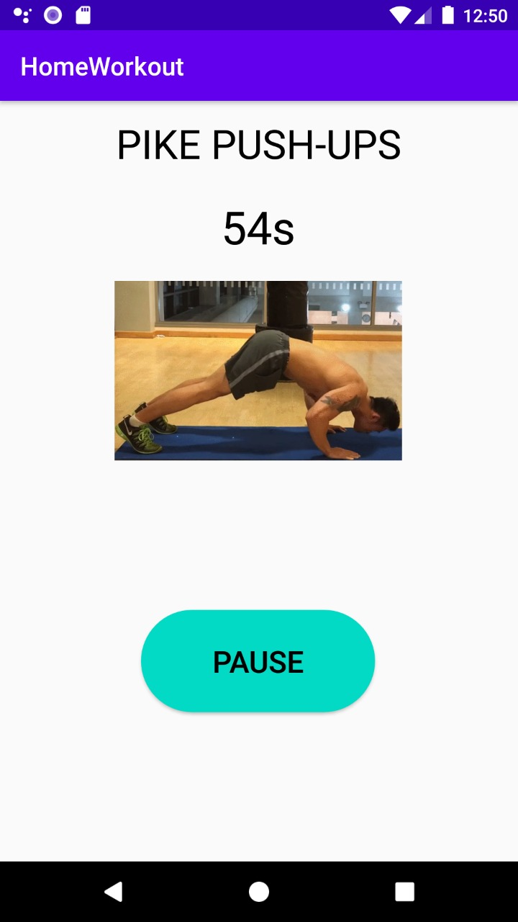
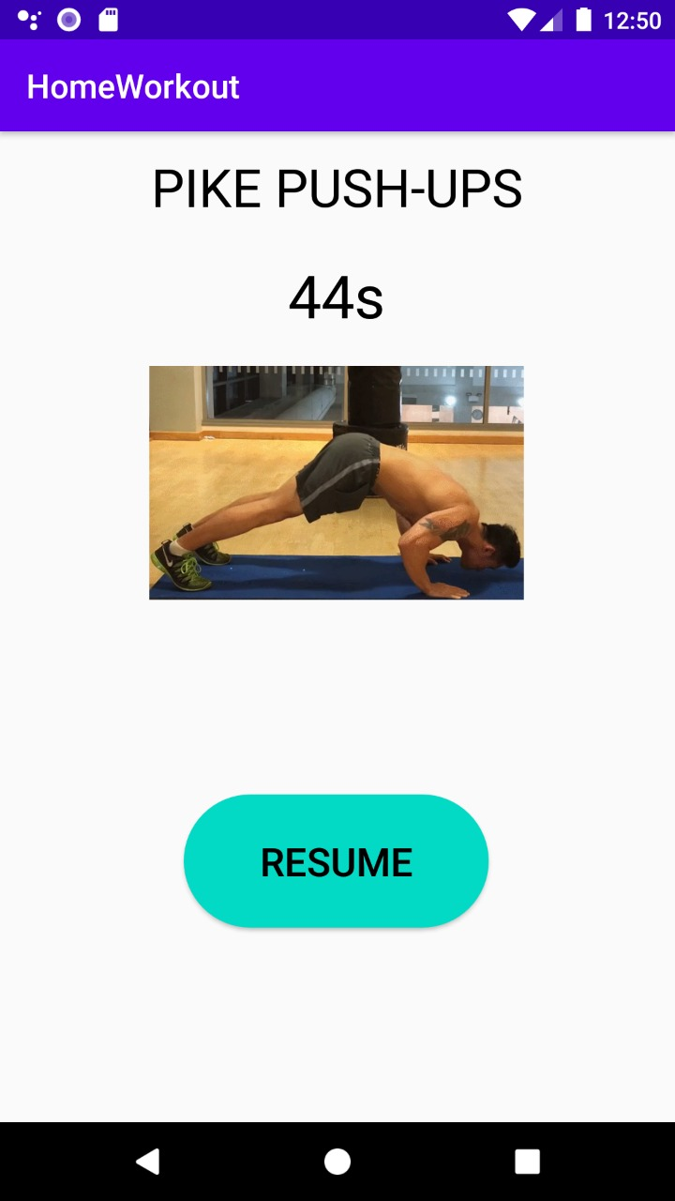
Exercise Page
Exercise Paused
Exercise resumed

Slide 16
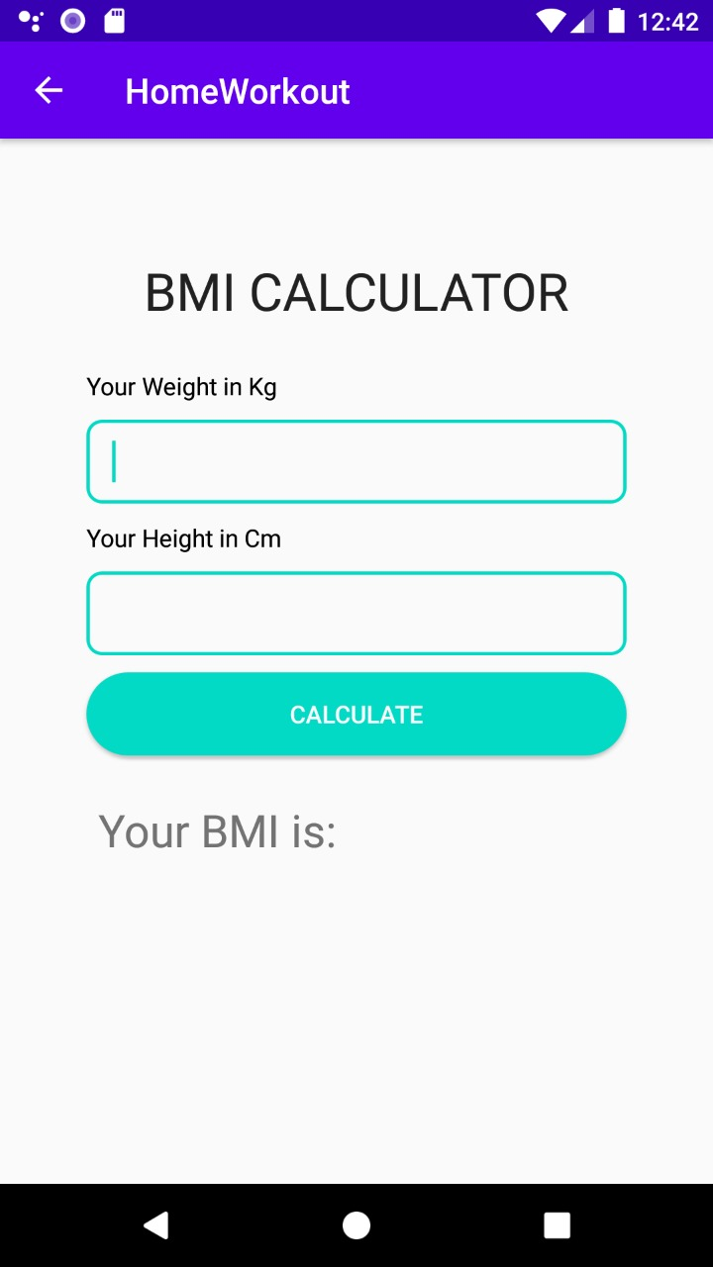
BMI Calculator

Slide 17
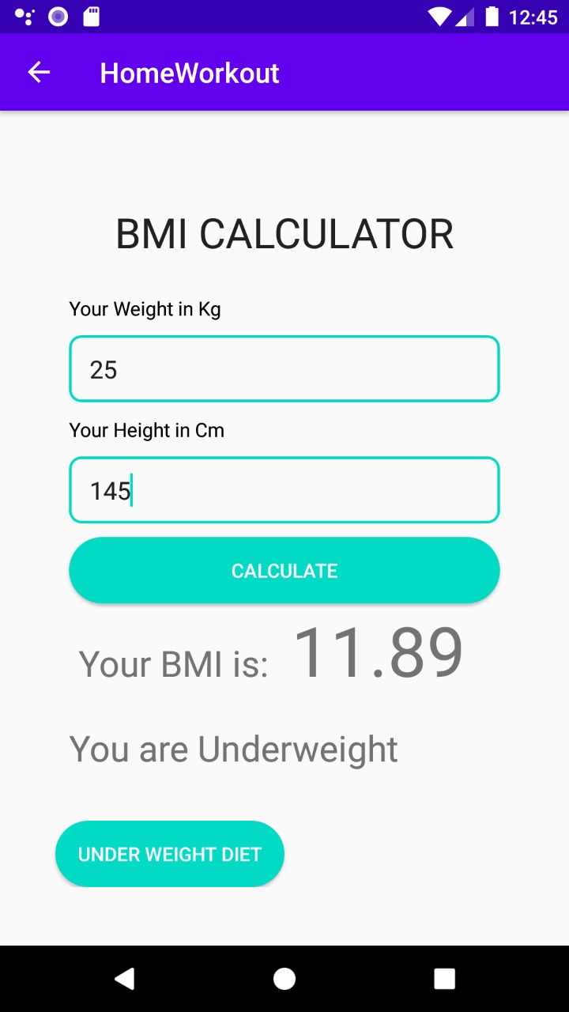
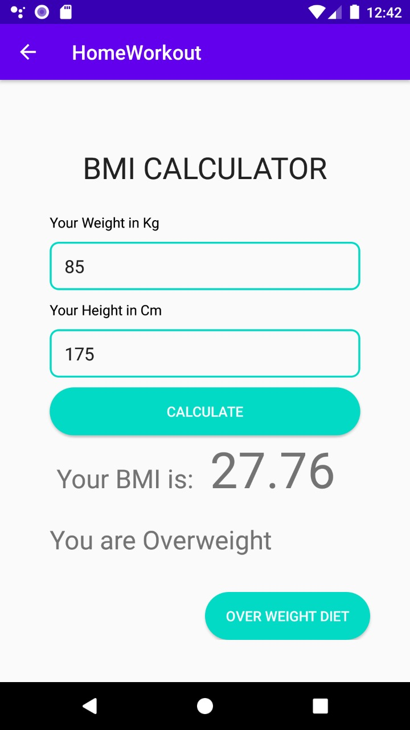
BMI Result and Diet
Underweight
Overweight

Slide 18
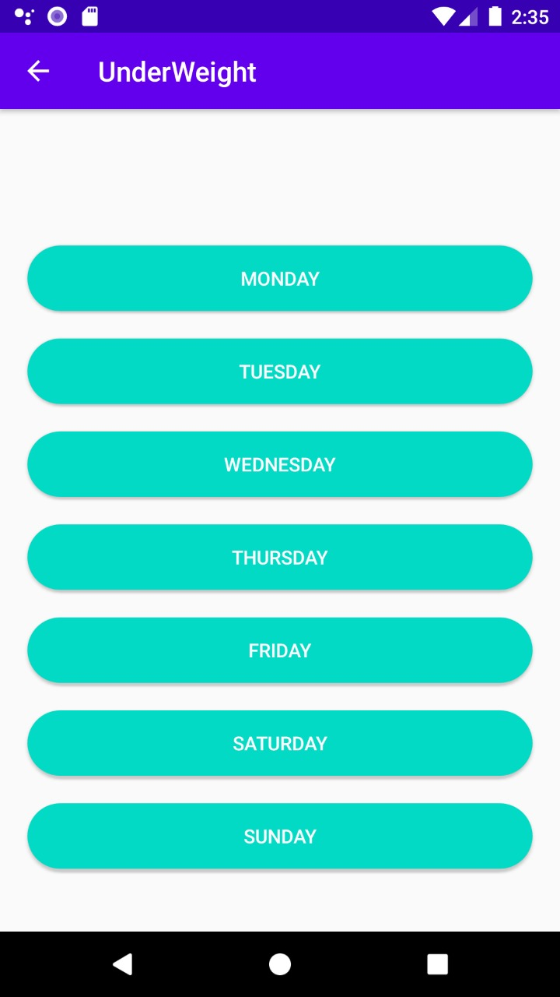
Day Selection Page

Slide 19
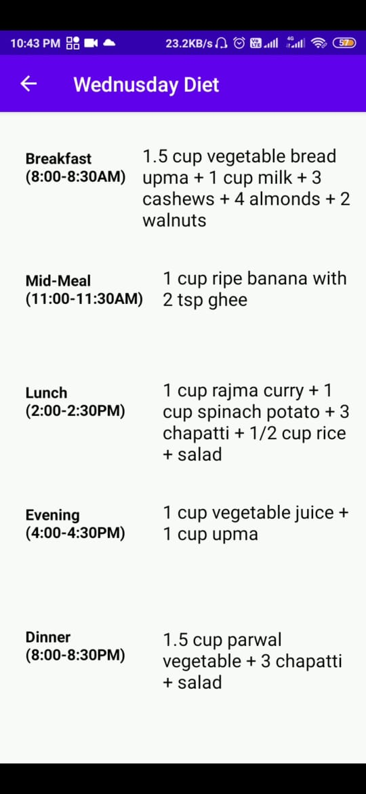
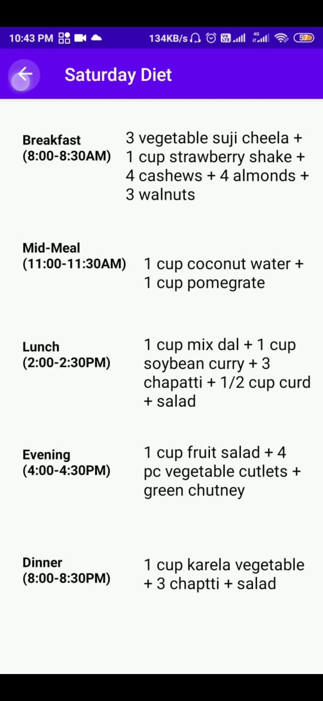
Diet Chart

Slide 20
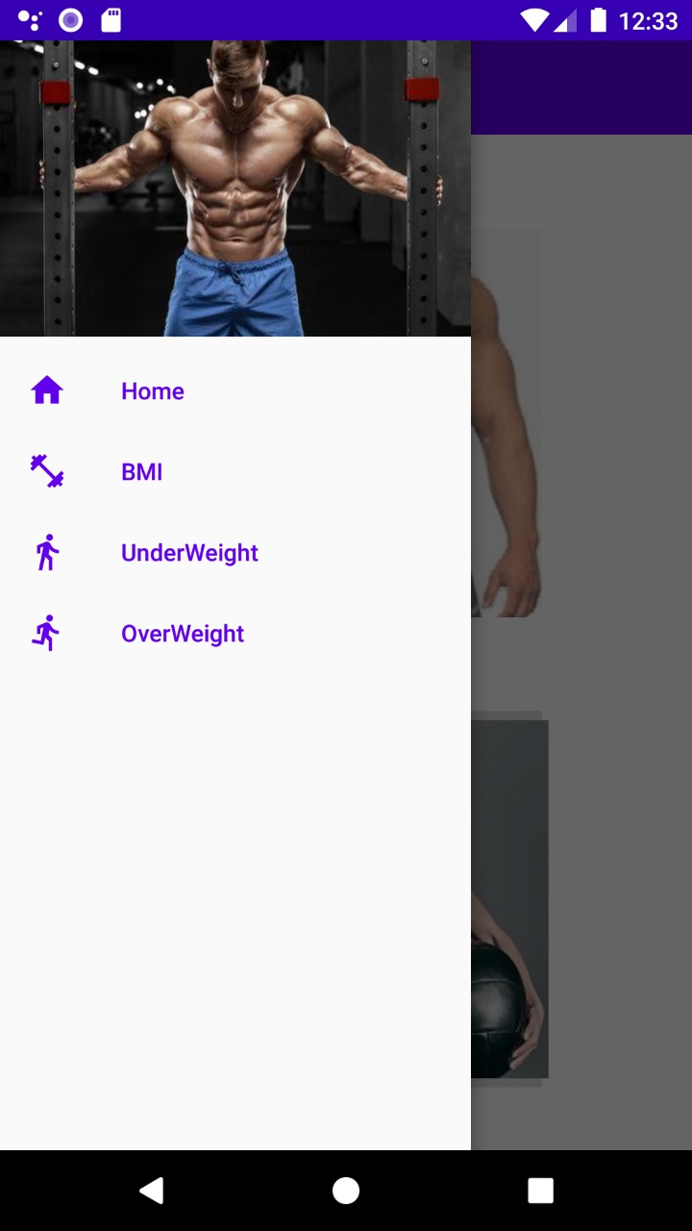
Navigation Bar

Slide 21
Conclusion
The main purpose of our project is to develop an application that offers new aspects of a healthy lifestyle in lifestyle area. Most of the available apps are entertainment-based, which mostly do not contribute to the heath of individuals. The significance of this project it's importance in helping anyone want to be healthy or want to have fitness. It will help the people have a way to monitor the healthy food they are consuming. People will get everything at a single place without engaging in different applications. This project adds values in the areas of health and fitness by add active application on mobile devices aimed to have the same functionality. The market needs an applications facilitate people save and archive with their data which this application designed to do it.
This app contains exercises that can be easily done at home based on your gender. It also contains diet chart on a weekly basis according to your weight along with a BMI calculator. We have found that the data collection process is hard and time-consuming, but it can be managed by a team work. We hope that other developers will take advantage from our experience/from our development.

Slide 22
THANK YOU

